Slide 1
Teamwork
A few Notes

Slide 2
This May be your most comprehensive, realistic Team project experience in college …
A beginning and an end
Consistent team membership
7 cycles (spread over 10 weeks)
Negotiation of schedules
Areas of expertise
Frequent team communication and cooperation
… pretty much normal work in business
IT IS A chance to grow over the entire quarter

Slide 3
Comments from PREVIOUS successful teams …
“Here, everyone helps and supports you.”
“I met new people and learned a lot from them. They do not mind sharing their expertise.”

Slide 4
SDLC, XP, Agile, Peer programming…
How to organize the development of a Project
  SDLC (MIS 321)
How to organize the Developers (MIS 421)
  XP
  Agile, Agile X
    Iterations
    Scrum
    Peer Programming

Slide 5





Peer Programming
Mentor
a.k.a. Brakeman
Driver
Navigator
“Peer Programming (sometimes referred to as [pair] programming) is an agile software development technique in which two [or three] programmers work as a [team] together on one workstation. One, the driver, writes code while the other, the observer, pointer or navigator reviews each line of code as it is typed in.”
“The two programmers switch roles frequently. …” [Wikipedia: http://en.wikipedia.org/wiki/Pair_programming

Slide 6
Mentor
a.k.a. Brakeman
Driver
Navigator
[Peers] switch frequently between these roles (sometimes passing the keyboard over every few minutes).
http://accu.org/index.php/journals/1395

Slide 7


NOTES ON PEER PROGRAMMING
Three roles:
  Navigator (eyes on screen and instructions; feeds instructions to others; updates workflow record)
  Driver (eyes on screen: hands on keyboard, takes instructions)
  Mentor (eyes on screen; offers advice, corrections and tips)
    A.K.A. “Brakeman” (puts on the brakes.) Asking questions …
      …makes people pause to justify what they are doing.
      …improves the amount of communication and each person’s communication skills.
      …keeps everyone informed about what and how the software works.
      …teaches shy people to speak out … even when they are unsure.

Slide 8

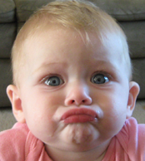
Impatient Hotshot
A.K.A. “Runaway Driver”
Unhappy
Passenger
Free Rider
Disruptive Practices to Avoid

Slide 9
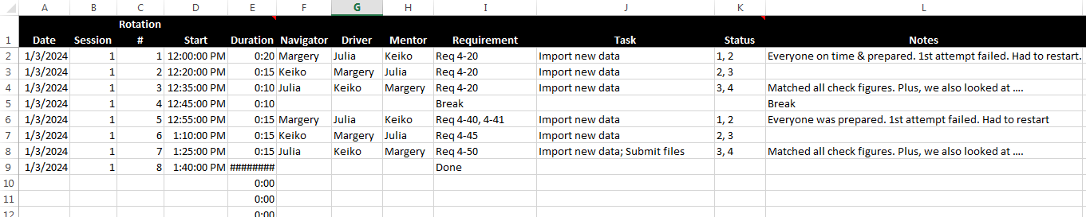
NOTES ON PEER PROGRAMMING
  Recordkeeping
  Responsibilities common to all roles:
    Read instructions before each development session
    Read preparation materials before each development session
    Arrive on time, ready to work
    Own the spirit of each role
    Rotate frequently between roles
  Post-session Debrief of “teamwork”
    What was working well?
    What was not working?
    Did each person fulfill appropriate responsibilities?
  Peer Evaluation

Slide 10
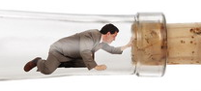


Communication
Don’t be a bottleneck. CC your teammates
CC everyone in your group

