Slide 1
Backup Tables in SQL Server

Slide 2
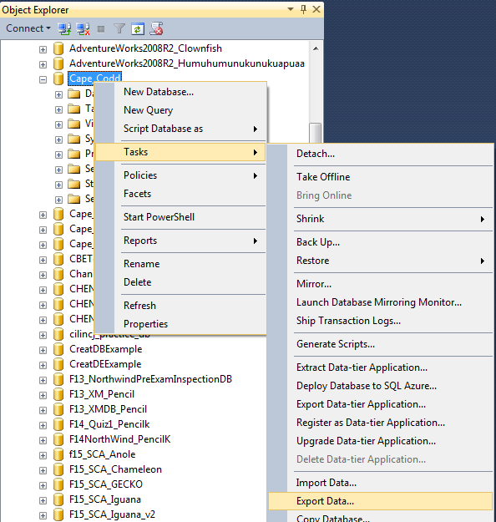
Backup Table Method
Cape_Codd database is used in this example
Righ click the database that contains the table you want to backup, then Tasks -> Export Data…

Slide 3
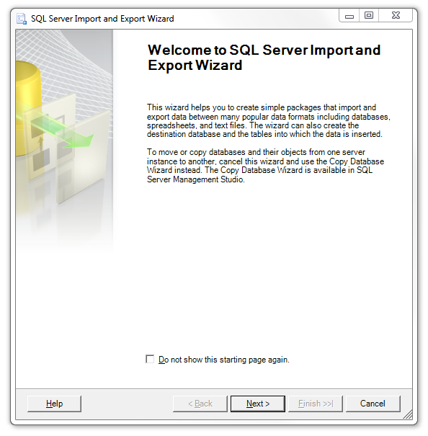
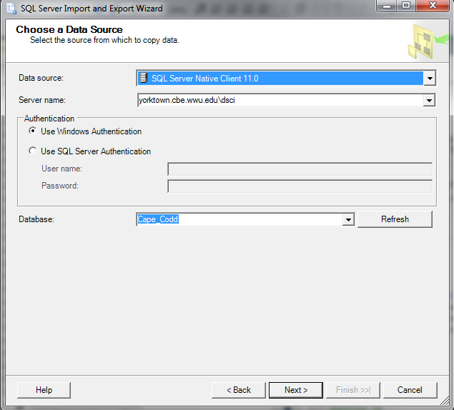
Backup Table Method
Click Next > on the “Welcome to SQL Server Import and Export Wizard” window if it comes up. Then click Next > on the “Choose a Data Source” window
The Server name should have the value of Yorktown.cbe.wwu.edu\dsci
The Database should have the value of the database name you right clicked in step 1. The sample database name is Cape_Codd. You should use your own database name for your project assignments

Slide 4
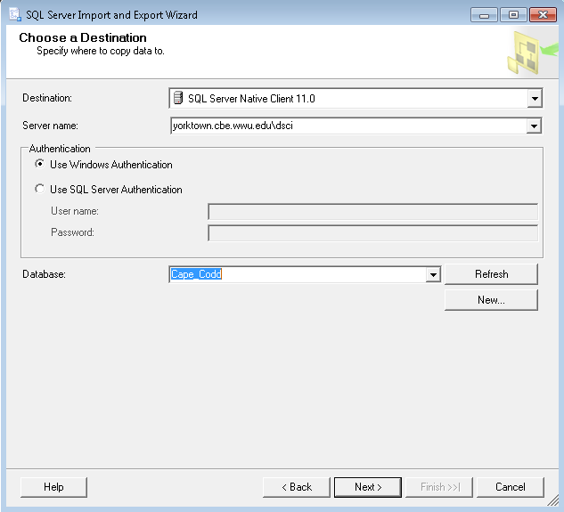
Backup Table Method
3. In the “Choose a Destination” window type yorktown.cbe.wwu.edu\dsci for the Server name Then choose the same database you right-clicked in step 1 (In this example, it is Cape_Codd)

Slide 5
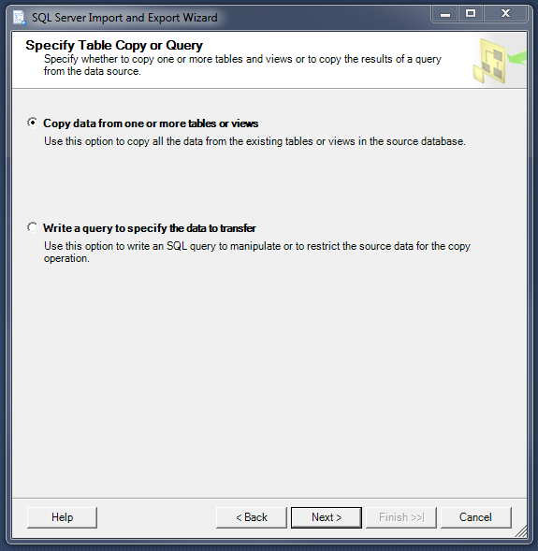
Backup Table Method
4. On the “Specify Table: Copy or Query” window: Select “Copy data from one or more tables or views” and click Next >

Slide 6
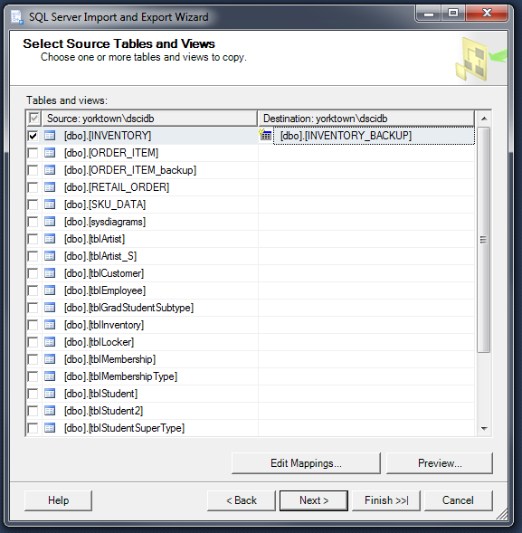
Backup Table Method
5. On the “Select Source Tables and Views” window, select the table you want to backup. [dbo].[INVENTORY] is selected in this example Add _BACKUP to the Destination table name.
Add _BACKUP to the destination table name

Slide 7
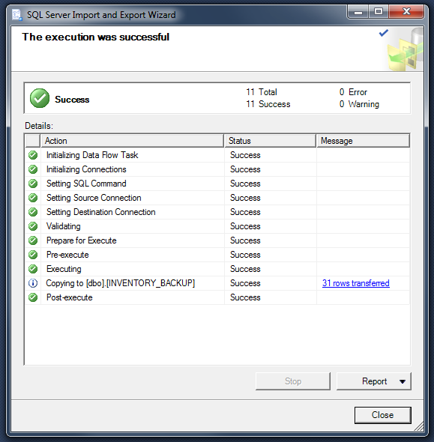
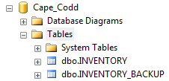
Backup Table Method
6. Click Next or Finish until you reach this screen.
7. Verify that there are no errors for the execution. (Errors display a red “x” instead of a green check mark.)
8. Refresh the Tables folder to verify that your new backup table has been created in your database.

Slide 8
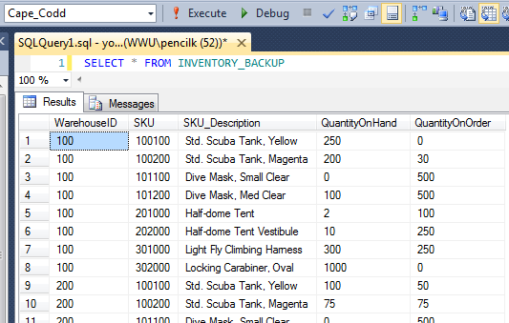
Backup Table Method
9. Run a script to select all data from the backup table to make sure all the data rows and columns have been included in the new table. Verify that no data has been corrupted or changed.
In this example: SELECT * FROM INVENTORY_BACKUP

